Slide 1
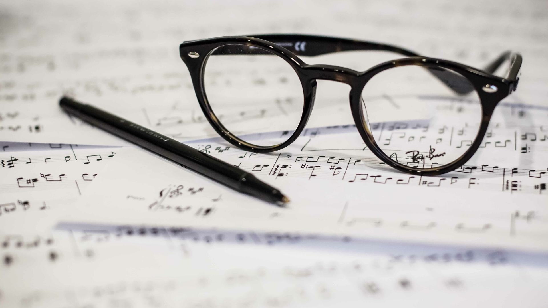
Songwriter's Lament
Christian Gonzalez, Nick Schoess, Will Sorn, Tim Tanner

Slide 2

Elevator pitch
Whether you’re a well-established wordsmith or someone who's never written a song before, inspiration can strike at any moment. Could that phrase fit into the
Whether you’re a well-established wordsmith or someone who's never written a song before, inspiration can strike at any moment. Could that phrase fit into the perfect chorus for a new song? Could that melody you've had stuck in your head be the next "God's Plan"? Use this app to jot down your ideas, melodies, and lyrics to turn those seeds of inspiration into actual songs. Use this tool to help organize your lyrics and recordings before those fleeting thoughts have passed.

Slide 3

Concept
Description
Songwriter’s Lament is a a musical composer’s app that lets an artist input information about their songs and everything you can think of associated to it. First an Artist must authenticate themselves using their name and password. Whenever a user submits a new song, the app will display the all the information you’ve saved regarding the song. An artist can save as many tunes as they can think of. Artist and song information is stored in a data base for future reference.
Motivation for development?
The love of music
User Story
As a musical writer, I need an application that will store my musical thoughts so I don’t waste time rethinking concepts or forgetting good ideas.
WHEN an artist enters a username; THEN that username is checked against existing username (artist name) database
WHEN the username already exists; THEN the page redirects to the main dashboard with all of the previously saved songs populating
WHEN the username DOESNT exist; THEN the username is added to the database and the user is brought to the main dashboard which is then blank
WHEN an artist enters information about their songs, Then that data is stored in a database.
WHEN an artist deletes the song, the song is removed from the data base.
WHEN an artist updates song information, the song is updated in the data base.

Slide 4

Process
Technologies used - Node and Express server; Handlebars.js; MySQL with a Sequelize ORM; GET and POST routs; Passport; deployed using Heroku
Breakdown of tasks and roles
Backend / Data Base / Passport Authentication – Nick and Tim
Front-end / Javascript / Handlebars – Christian and Will
Challenges
Breaking down the work
Passport, Handlebars
Success
Cool project and teamwork
Ability to apply class knowledge

Slide 5

Demo

Slide 6

Future Development
Lyrical help… Rhymes, Phrases, Word Families
Musical influencers search
A Phrase Dictionary
Speech types, aka, different figures of speech
A synonym finder; a thesaurus of sorts
Sharing songs with friends to get feedback and ratings
Extended complement of attributes and information

Slide 7

Links
[Heroku Link]
https://github.com/schoess/Project_2

